Slide 1
PacMan Assignment
Code Explanation
by
Kuganeswaran Letshimanan
WID1700021
17107141/1

Slide 2
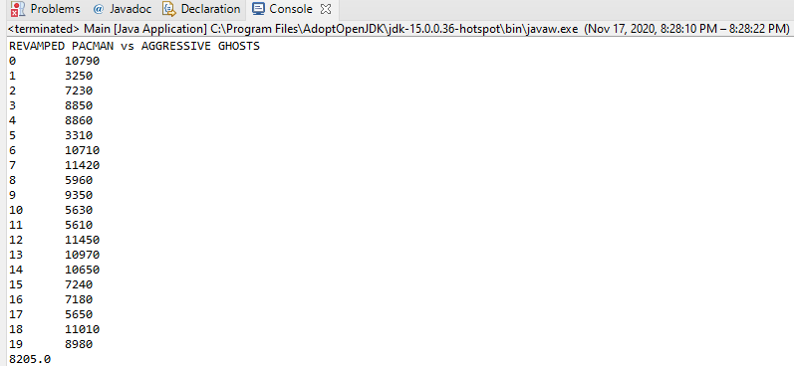
The Results (REVAMPED PACMAN VS AGGRESSIVE GHOSTS

Slide 3
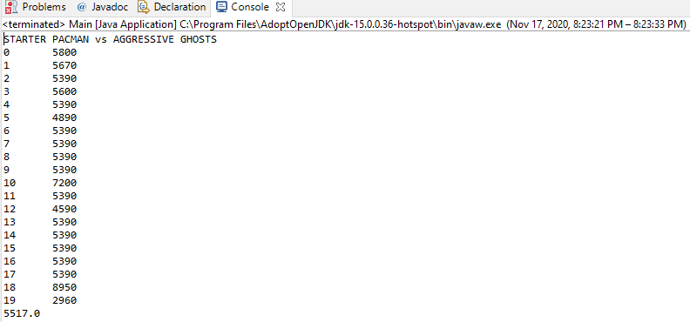
The Results (STARTER PACMAN VS AGGRESSIVE GHOSTS)
The Results (REVAMPED PACMAN VS AGGRESSIVE GHOSTS

Slide 4
For this assignment I used the revapmped pacman class where it uses threshold distance approach.
A threshold distance will be computed for you, but this may not be the most appropriate distance for your analysis.
The default distance threshold will be the minimum distance that ensures every feature has at least one neighbor.

Slide 5
LINE 13 to 25
is where we initiate our threshold approach by creating 2 return types(t1 and t2) and store in a class called container
LINE 27 to 30
set of codes gives the pacman few choices of moves.
There are 5 ways to move whis-ch is up,down,left right or continuing the move it has done before
The amount of time left for the pacman to move around is time due.

Slide 6
LINE 32 to 56
this part decides the next move of the pacman in the game from the given few directions stated above.
there are a total of 4 strategies in this code
Strategy 1:Moving away from the nearest ghost
LINE 34 to 39
the container will hold the nearest ghost and distance as item2
when item 2 is less than the threshold distance
item 1 will get the current ghost node index
then the pacman will move away from the ghost

Slide 7
Strategy 2:Chase edible ghost
LINE 40 to 45
if the edible ghost value is not equals no zero then the pacman
will move towards the edible ghosts
Strategy 3:Eat the nearest pill
LINE46 to 51
if the pills value is more than 0 ,the pacman will get
the closeset node index from the pill and move towards it

Slide 8
Strategy 4:Search for the best move
LINE 52 to 56
the pacmans last move and the possible moves will be stored .It will return the opposite of the previous moves if the length of the moves is more than 0
LINE 58 to 77
this part of the code is where we will compute the nearest ghost from the pacman and its shortest distance and keep it in the container will be used when using the strategie 1

Slide 9
LINE 79-96
this part is to compute the nearest edible ghost from the pacman that was used in strategy 2
LINE 98-108
the code will get the indices of all the active pills in the game and return it to be used in strategy 3

